Slide 1
The Future of the Windows Desktop
Using .Net Core 3 Features to Improve Support for Legacy Apps

Slide 2
Paul Michaels
Plug for the book
My Blog:
https://www.pmichaels.net/
This talk:
https://github.com/pcmichaels/WindowsDesktopTalk
pmichaels.net
@paul_michaels
Notes:
Talk about how I started
Spectrum ‘83/84 48K Spectrum ZX.
Display of hands: Anyone owned a spectrum? Anyone programmed on a spectrum? Anyone heard of functions in Spectrum Basic?
1997 – professional programmer - Pascal

Slide 3
Why?
Haven’t we all agreed on the web?
Notes:
This talk is about running desktop applications on .Net Core 3. Why would we want to do that?
Next slide - legacy

Slide 4
Legacy
- WinForms
- WPF
- UWP?
Notes:
You may have legacy apps running on earlier versions of the framework
Where does this leave UWP?

Slide 5
Still a place for desktop?
NO client server traffic for updating a screen
Scaleable (you should only make calls when you need to read from or write to the server)
Total control over your environment
Arguably faster to write (certainly WinForms)
No need for an internet connection
Notes:
Selling the desktop

Slide 6
WinForms – Is it all that bad?
It really is
But…
.Net Framework
Try employing people to work on it!
Platform Specific
Typically not very testable, and not very tested
Hard to deploy
Fast to develop
Your apps may already be written and running
Users are used to it – everyone likes battleship grey!

Slide 7

Demo – Migrate WinForms to .Net Core
Notes:
Show GenerateLargeFiles
Helpers
Portability analyser
Steps to upgrade:
Create a new project in the same solution
Add existing files (see the compile include – compile include wildcard – can’t do a full wildcard, because it includes all the .Net Framework directories - properties, etc..)
Add NuGet packages
Speed! Around ¼ to 1/3 faster
Following slides are what we did in the demo

Slide 8
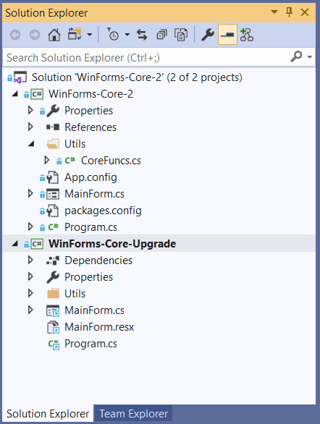
Create new Project
Notes:
You can upgrade in-situ – your choice

Slide 9
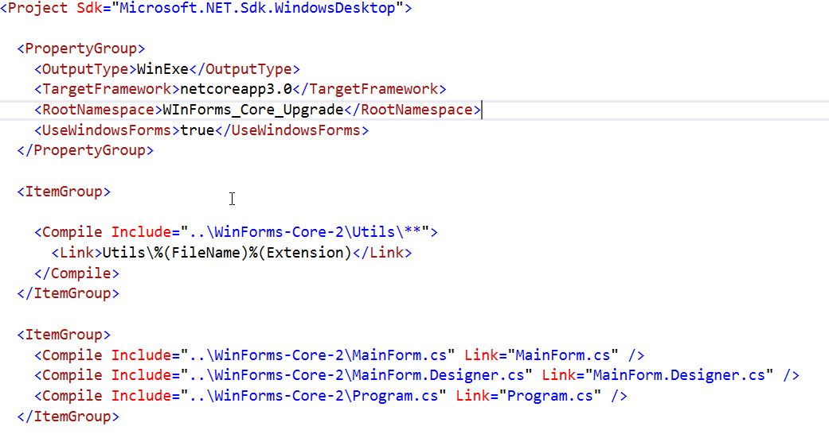
Add Existing Files
Notes:
You can also copy and paste

Slide 10
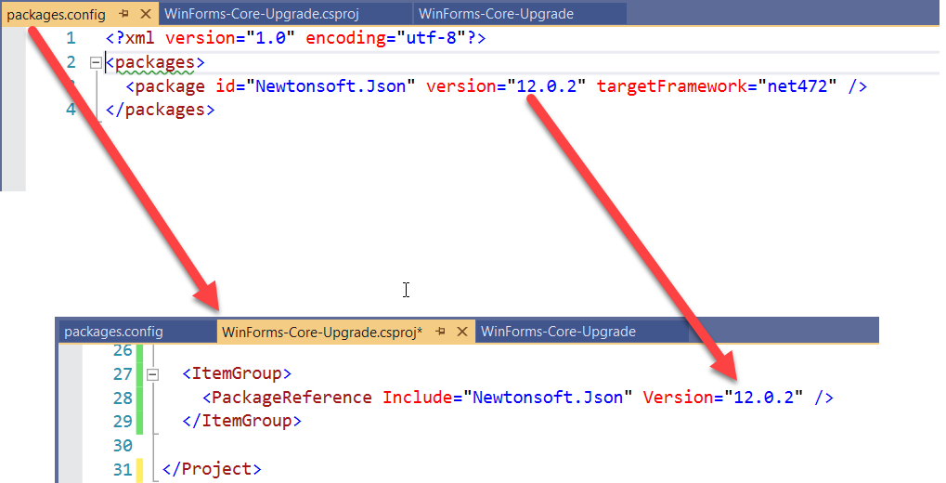
NuGet
Notes:
Packages.config -> csproj file

Slide 11
WinForms – Still all that bad?
.Net Framework
Try employing people to work on it!
Platform Specific
Typically not very testable, and not very tested
Hard to deploy
.Net Core 3
Still platform specific, but that’s probably what you want
If your app isn’t properly tested, this won’t help you!
Single exe and tree shaking!

Slide 12

Demo – Single Exe and Tree Shaking
Notes:
Publish the app as is
Runtime identifier (includes the runtime by default)
SelfContained = false (back to default)
PublishSingleFile (note file size)
PubishTrimmed (note file size)

Slide 13
Tree Shaking, Compilation and Single Exe
PublishSingleFile (output as a single exe)
RuntimeIdentifier (target platform)
PublishReadyToRun (compiled – sort of – just faster)
PublishTrimmed (tree shaking)
SelfContained (include the runtime – defaults to true where the runtime identifier is set)

Slide 14
WPF – The Kiosk Application
WPF is cool isn’t it?
It was
Xaml (XML is the language that Json could have been!)
Similar to UWP and Xamarin Xaml
Xaml standards are supposed to be aligning… soon
Binding (features)
Testability (Compared to WinForms!)
MVVM
Can be (sort of) cross platform
INotifyPropertyChanged
Binding (complexity)
Resources
Deployment (ClickOnce)
Not exactly cutting edge technology!
Notes:
Every WPF App seems to be a kiosk application

Slide 15

(Very Quick) Demo – WPF to .Net Core 3

Slide 16
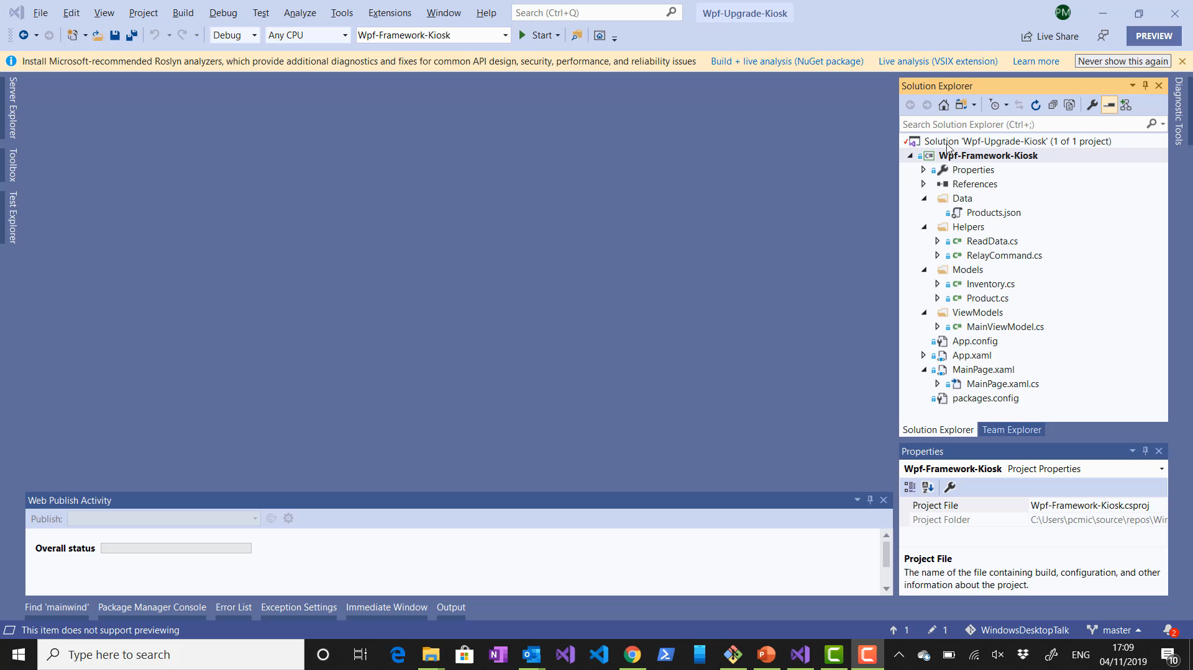

Slide 17
WPF – Still tech from 2006?
INotifyPropertyChanged
Binding (Complexity)
Resources
Deployment (ClickOnce)
Not Exactly Cutting Edge Technology!
If this was problem before, then it still is!
MSix
.Net Core 3

Slide 18
MSix
Works with any desktop app (WPF & Winforms) – doesn’t have to be .Net Core 3!
Only really Windows 10
Install UWP Workload
Publish to Store or Azure App Service

Slide 19
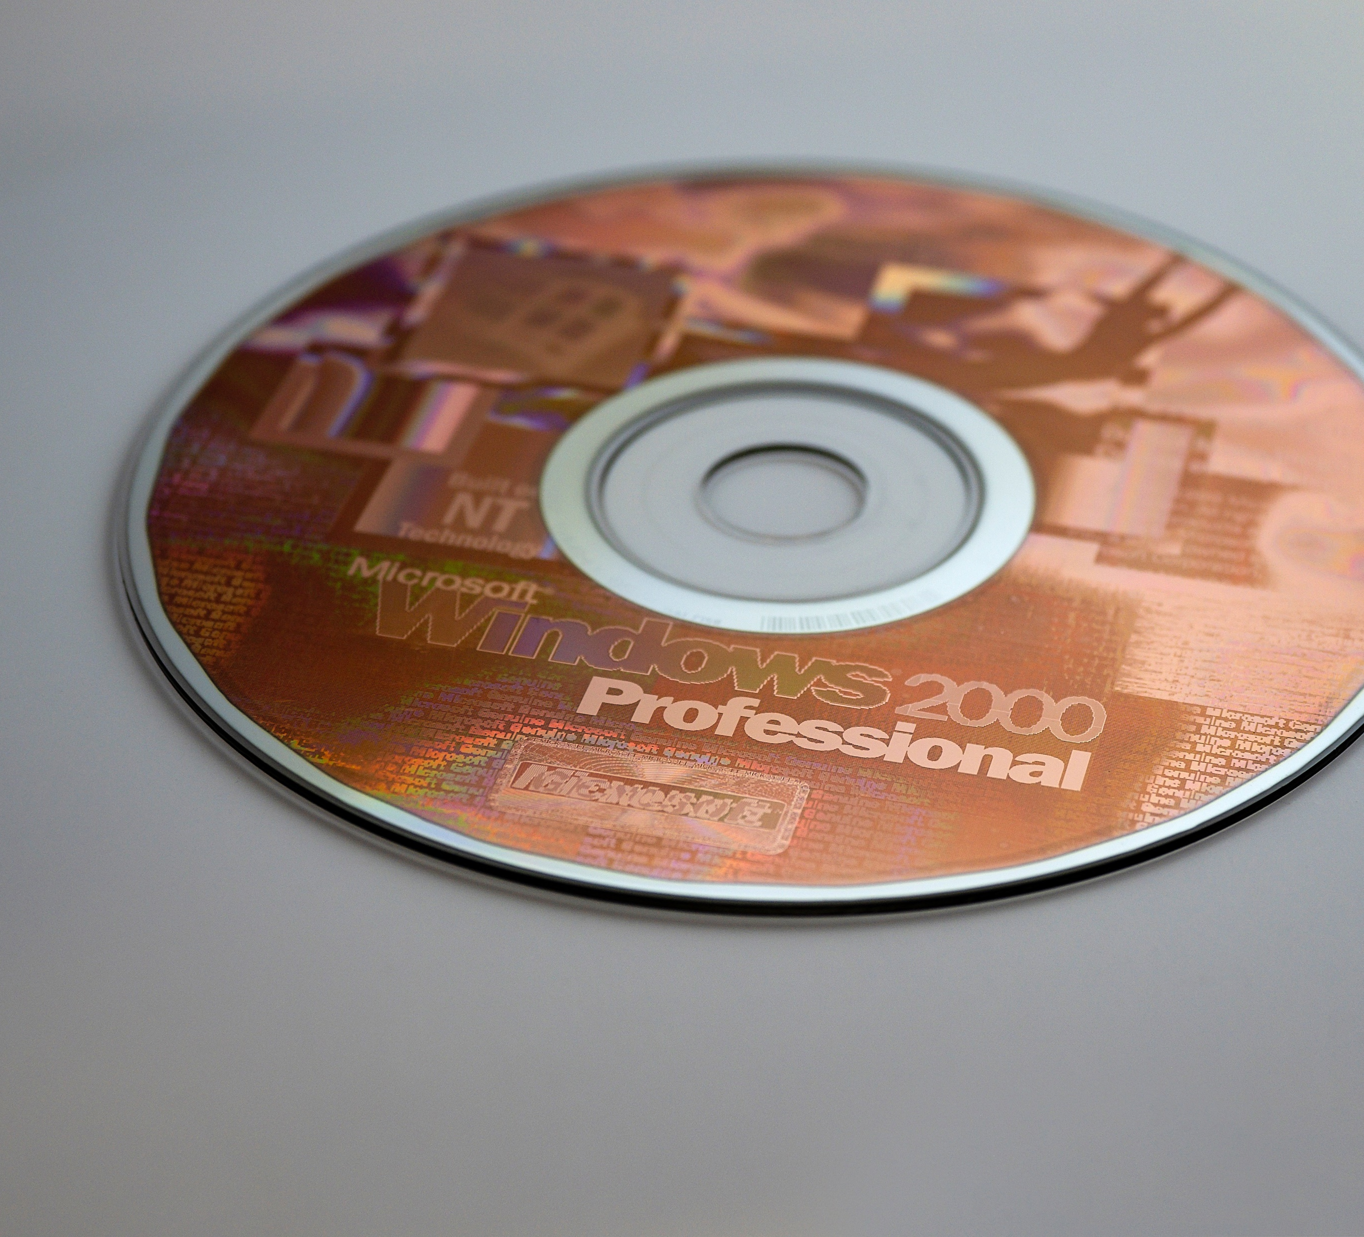
MSix Demo

Slide 20
Xaml Islands
Create Controls in UWP that can be used in WinForms or WPF
Starting from Windows 10 - 1903
WindowsXamlHost control for custom controls
WebView
Embed auth in winforms and WPF apps
Custom Controls are still in preview

Slide 21

Demo - Xaml Islands
Notes:
Following slides cover creating custom UWP control library

Slide 22
Create Custom UWP Control
Create new project: Class Library (Universal Windows)
Disable EnableTypeInfoReflection and EnableXBindDiagnostics
Add the UserControl
Create a WPF Application
Add the WindowsXamlHost
Add app.manifest, or package the project

Slide 23
What does this mean for the future of Desktop Development?
Take legacy apps and improve them from the outside in
The WinForms app that’s being running the nuclear reactor for the last 15 years can be upgraded without the risk of pulling it apart
WinForms and WPF apps can now be deployed to the Microsoft Store… which will promptly fill up with Kiosk apps!
XAML looks to be staying as the language of the desktop - .Net 5 is set to see this standardise
ClickOnce is dead – long live MSix !

Slide 24
Should I Create a New Desktop App?
There are still issues with desktop apps:
C# code is downloaded locally and so IP is exposed (true also for Blazor client)
MSix does solve some of the deployment issues, but now you’re in a sandbox
It’s still difficult to get people to work on the desktop
Desktop apps have their place:
Large amount of offline work
Intensive graphic manipulation
Complex UIs with state

Slide 25
If I do Create a new Desktop App, what should I use?
WinForms:
VERY fast to get simple functionality up and running
Still a VERY low barrier to entry
If you’re not using MVVM or binding, you might as well use WinForms
WPF:
Using XAML, so if you’re using XAML, you should probably be creating a UWP app
Do you really need the very specific complex binding or animations that aren’t available in UWP?
UWP:
Seems to be the MS recommendation (although VS Code is written in electron!)
Supports MOST of the WPF XAML in one way or another (multi-binding, triggers, etc. not supported still)

Slide 26
The Windows Desktop Alternatives
Electron (VS Code – picks up where WinJS left off, but cross platform)
Blazor – Client Side
Xamarin
Flutter (Google – using Dart)
Roll your own
Notes:
Roll your own - monogame

Slide 27
Summary
Windows Desktop is NOT dead
Surprisingly, WinForms seems to be more viable than WPF now

Slide 28
Questions

